Slide 1
Introduction to Azure Arc-Enabled Data Services
Why everything must be named Ben

Slide 2

Rob Sewell
He/Him
Bearded Consultant
Automator
Trainer
Dual MVP
Consultant Sewells Consulting Ltd
dbatoolsMoL dbachecks
ADSNotebooks PowerShell Community
Data Community
beard.media\book
@sqldbawithbeard
blog.robsewell.com

Slide 3
Why Azure Arc-Enabled Data Services?

Slide 4
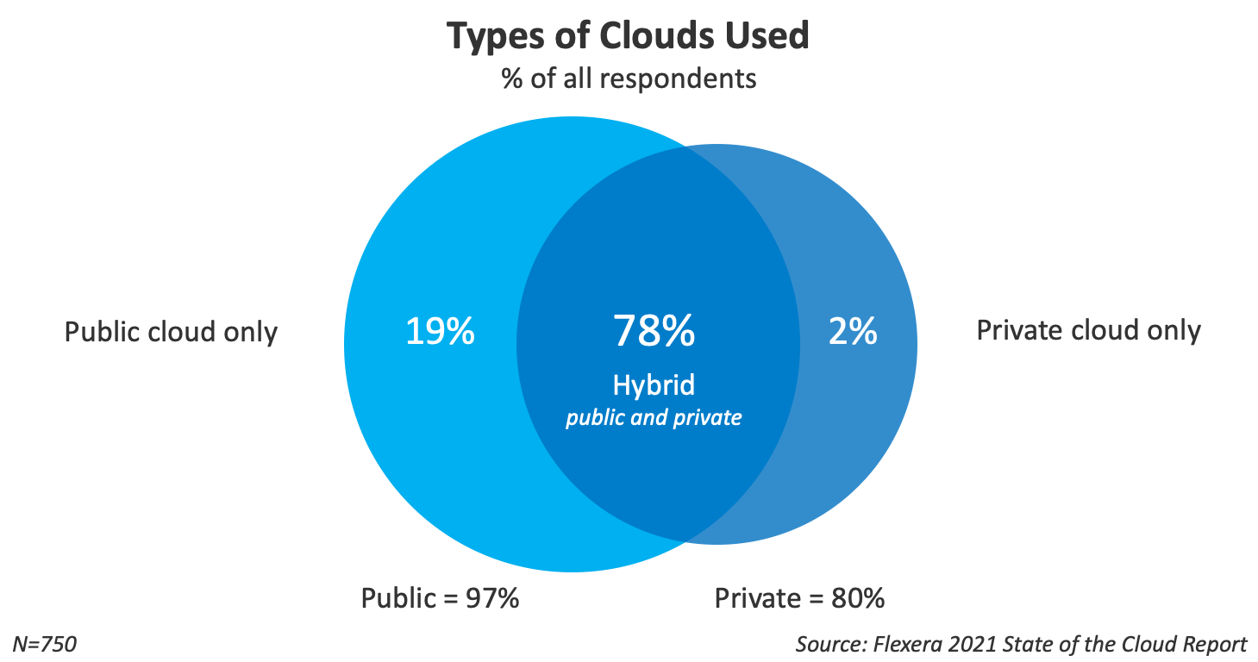

Slide 5
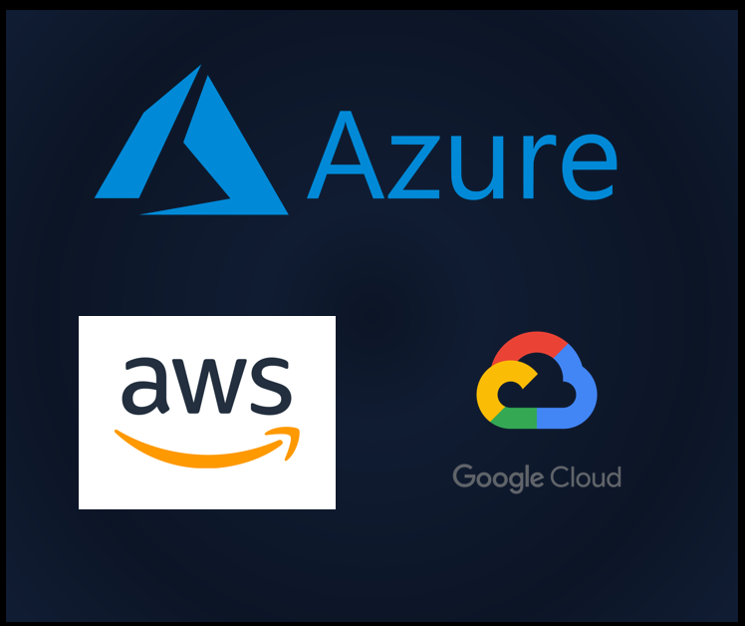
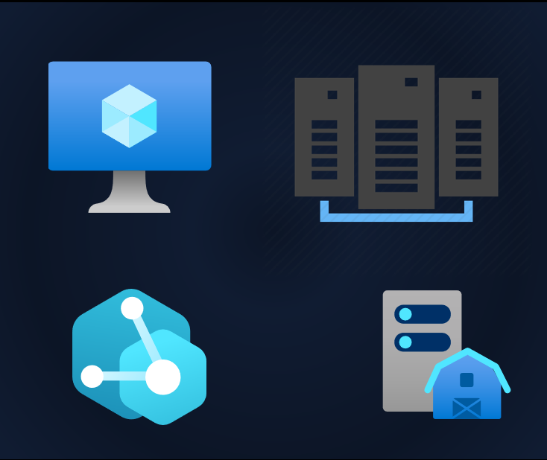
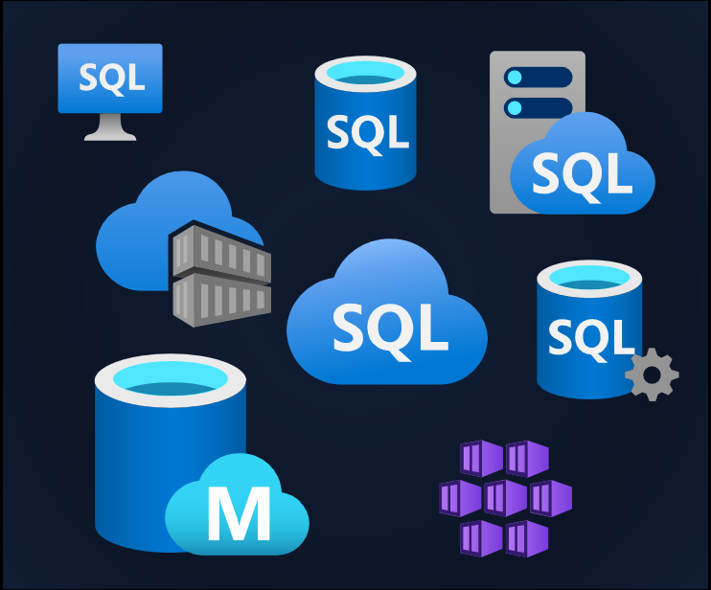
Our Services Are Everywhere

Slide 6


Management is Everywhere
Photo by Ashim D’Silva on Unsplash

Slide 7




Azure 3
Security, operations, and governance
Tools and experiences
Azure services
Azure Arc enabled services
Azure Arc
Cloud infrastructure
Azure Arc enabled infrastructure + devices
Innovate anywhere
Cloud regions
Regional edge
IT edge
IoT edge
50+ Azure regions
Multicloud
Operator DC
Co-Lo provider
Customer DC
Branch office
Factory floor
Retail store
Field production

Slide 8








Migrate and Modernize to Azure on your own terms
Azure Arc helps you consistently secure and govern infrastructure across hybrid environments as you migrate and modernize.
100 x On-Premises and/or multicloud Servers (Windows/Linux/SQL)
70 x Azure VMs
Servers that are ready to move to the cloud
Microsoft Defender for Cloud
Migrate to Azure
Turn on Azure security, monitoring and governance services for all servers no matter where you are in the migration journey
Microsoft Sentinel
30 Arc-enabled servers
Servers that are not ready to move to the cloud
Azure Policy
Onboard to Azure Arc
Azure Monitor

Slide 9
Always up to date / “evergreen” with automated updates

Slide 10



Azure Arc-enabled data services
Existing apps
App modernization
Azure Arc-enabled
SQL Server
Azure Arc-enabled SQL Managed Instance
Azure Arc-enabled PostgreSQL
Organize, inventory
Enhanced security with Microsoft Defender for Cloud
Free SQL Assessment service
Azure SQL Managed Instance
on any infrastructure
Fully automated, evergreen SQL
Cloud billing model for on-premises
Azure Database for PostgreSQL
on any infrastructure
Fully automated, single server
Scale up/down/out/in
GENERALLY AVAILABLE
GENERALLY AVAILABLE
PUBLIC PREVIEW

Slide 11






Azure Arc-enabled data services | App Modernization
Bring cloud data management to any infrastructure
Supports all connectivity modes
Always up to date
Multi-layer security
Elastic scale
Simplified DevOps
Automated updates
No downtime, evergreen
Comprehensive encryption
Azure RBAC & Policy
Scale up and down
Pay for what you use
Deploy in seconds
Built in HA/DR
Any infrastructure

Slide 12
Arc-enabled SQL MI Business Critical
For your most mission-critical workloads at exceptional value
Feature parity with SQL Server Enterprise edition
High availability with Always On Availability Group
Unlimited and flexible CPU and memory config
One passive replica for disaster recovery: free
First active replica for read scale-out: free
Developer edition for all dev/tests: free

Slide 13
Management capabilities comparison by deployment model
Connectivity Modes
Built-in capabilities
Indirectly Connected
Directly Connected
Automatic HA/DR
Self-service provisioning
Using Kubernetes tools, Azure Data Studio, or az CLI locally
+Using Azure Portal, Azure Policy, az CLI through ARM
Elastic / “Limitless” scalability
Using Kubernetes tools, Azure Data Studio, or az CLI locally
+Using Azure Portal, Azure Policy, az CLI through ARM
Billing
Export/upload to Azure. Some delay in visibility to costs incurred depending on upload frequency
Automatic, continuous feed of billing usage telemetry to Azure
Auto upgrade, patching
Container images must be pulled/pushed to a local registry
Container images come automatically, directly from Microsoft Container Registry
Auto backup-restore
Local backup/restore service for scheduled, frequent, fast backups and restores.
+Send backups to Azure Backup (future) for long-term, offsite retention
Monitoring
Local monitoring and log analytics. Manually export and upload to Azure Monitor.
+Auto send monitoring and logs to Azure Monitor. +Container Insights
Authentication
Kubernetes authentication
Active Directory for SQL endpoints
+Azure Active Directory
Role Based Access Control (RBAC)
Kubernetes RBAC
+Integrated with Azure RBAC
Inventory in Azure
Automatable or manual export/upload to Azure
Automatic sync to Azure
User experiences/tools
Kubernetes tools, Azure Data Studio, or az CLI locally
+Azure Portal, Azure Policy, az CLI through ARM
Security services
+Advanced Threat Protection (Future)
+Vulnerability Assessment (Future)
Items in blue text are optional, add-on Azure services with their own pricing model.

Slide 14
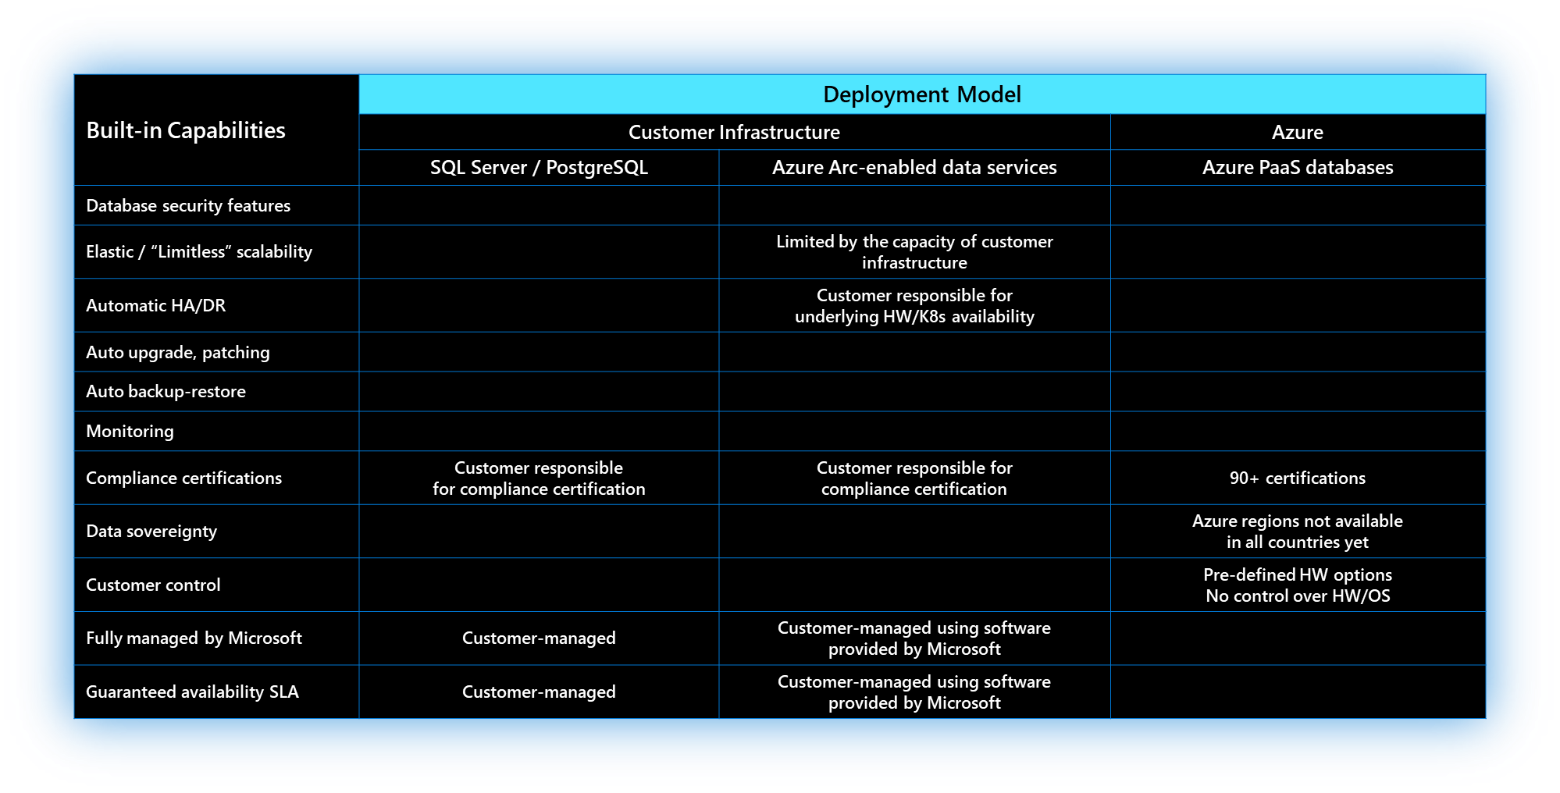
Azure Arc-enabled data services: management comparison

Slide 15
Database engine feature comparison by deployment model
Deployment Model
Customer Infrastructure
Azure
Built-in capabilities
SQL Server
SQL Managed Instance - Azure Arc
SQL Managed Instance
Database security features – TDE, AE, RLS
Agent
In-memory OLTP
Columnstore
Intelligent Query Processing
Always On Availability Groups/HA
In-database Machine Learning Services
Preview
Compression
Partitioning
Replication
Graph

Slide 16
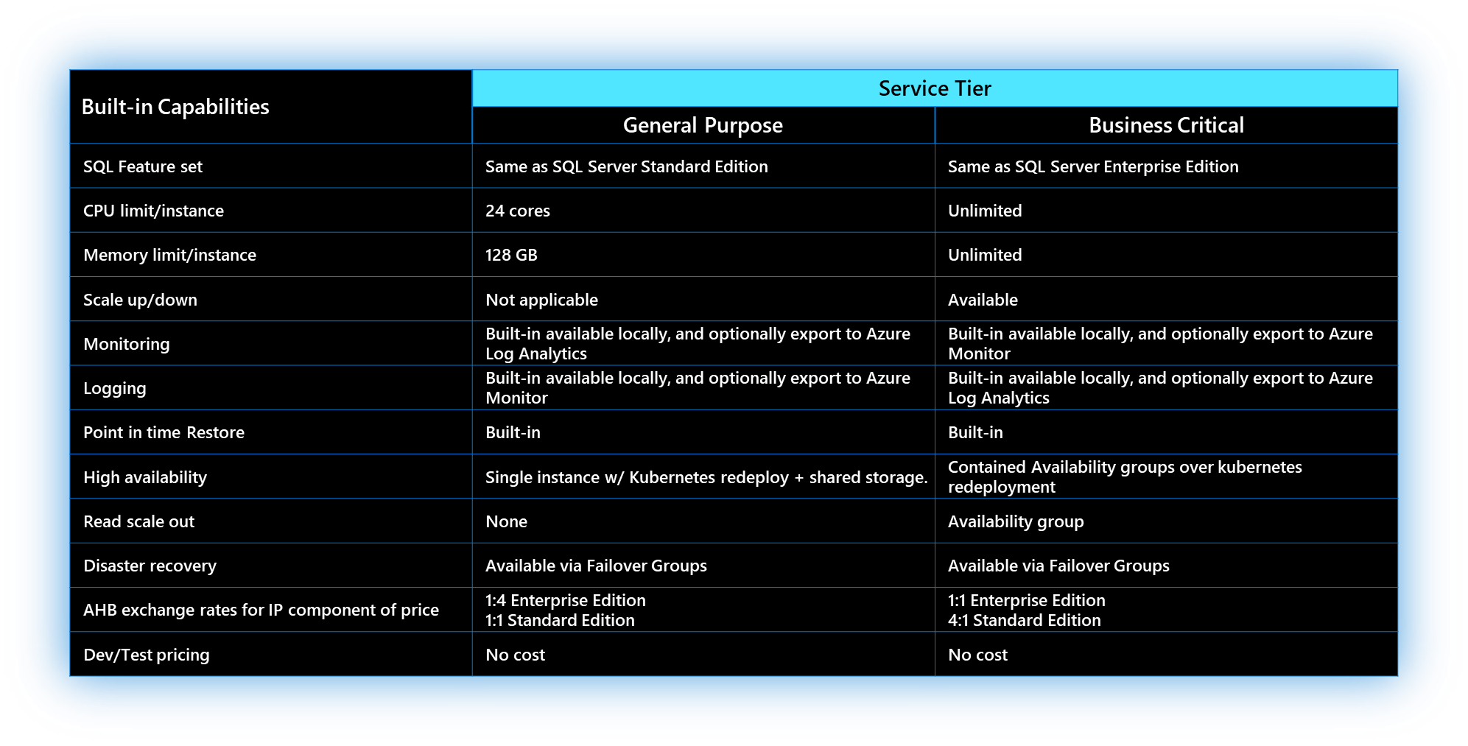
Business Critical vs. General Purpose
Service tier comparison

Slide 17
Always up to date / “evergreen” with automated updates

Slide 18



Azure Arc-enabled SQL Managed Instance
Business Critical rolling upgrades
1
2
3
4
5
K8s Worker Node
Evergreen database engine
Rolling upgrades without application downtime *Business Critical
No end of support
Monthly releases include security fixes, bug fixes, and new features
Directly Connected Mode
Azure Based System Maintenance Window Updates
Flexibility to choose your Maintenance Windows
Indirectly Connected Mode
Single Maintenance Window for all services
Data Controller
K8s Worker Node
K8s Worker Node
K8s Worker Node
K8s Worker Node
K8s Worker Node
K8s Worker Node
Pod
Pod
Pod
Pod
Pod
Pod
Availability
Group
Availability
Group
SQL MI
Primary
SQL MI
Primary
SQL MI
Secondary
SQL MI
SQL MI
Primary
SQL MI
Primary
SQL MI
SQL MI
Secondary
SQL MI
Secondary
SQL MI
Secondary
SQL MI
Secondary
SQL MI
SQL MI
Secondary
State: Unpatched
State: Patching
State: Patched
State: Unpatched
State: Patching
State: Unpatched
State: Unpatched
State: Patching
State: Patched
State: Unpatched
State: Unpatched
State: Unpatched
State: Unpatched
State: Patching
State: Unpatched

Slide 19
Azure Arc-enabled SQL Managed Instance
Business Critical rolling upgrades
1
2
3
4
5
K8s Worker Node
Evergreen database engine
Rolling upgrades without application downtime *Business Critical
No end of support
Monthly releases include security fixes, bug fixes, and new features
Directly Connected Mode
Azure Based System Maintenance Window Updates
Flexibility to choose your Maintenance Windows
Indirectly Connected Mode
Single Maintenance Window for all services
Data Controller
K8s Worker Node
K8s Worker Node
K8s Worker Node
K8s Worker Node
K8s Worker Node
K8s Worker Node
Pod
Pod
Pod
Pod
Pod
Pod
Availability
Group
Availability
Group
SQL MI
Primary
SQL MI
Primary
SQL MI
Secondary
SQL MI
SQL MI
Primary
SQL MI
Primary
SQL MI
SQL MI
Secondary
SQL MI
Secondary
SQL MI
Secondary
SQL MI
Secondary
SQL MI
SQL MI
Secondary
State: Unpatched
State: Patching
State: Patched
State: Unpatched
State: Patching
State: Unpatched
State: Unpatched
State: Patching
State: Patched
State: Patching
State: Unpatched
State: Unpatched
State: Unpatched
State: Patching
State: Unpatched

Slide 20
Azure Arc-enabled SQL Managed Instance
Business Critical rolling upgrades
1
2
3
4
5
K8s Worker Node
Evergreen database engine
Rolling upgrades without application downtime *Business Critical
No end of support
Monthly releases include security fixes, bug fixes, and new features
Directly Connected Mode
Azure Based System Maintenance Window Updates
Flexibility to choose your Maintenance Windows
Indirectly Connected Mode
Single Maintenance Window for all services
Data Controller
K8s Worker Node
K8s Worker Node
K8s Worker Node
K8s Worker Node
K8s Worker Node
K8s Worker Node
Pod
Pod
Pod
Pod
Pod
Pod
Availability
Group
Availability
Group
SQL MI
Primary
SQL MI
Primary
SQL MI
Secondary
SQL MI
SQL MI
Primary
SQL MI
Primary
SQL MI
SQL MI
Secondary
SQL MI
Secondary
SQL MI
Secondary
SQL MI
Secondary
SQL MI
SQL MI
Secondary
State: Unpatched
State: Patching
State: Patched
State: Unpatched
State: Patching
State: Unpatched
State: Unpatched
State: Patching
State: Patched
State: Patched
State: Unpatched
State: Unpatched
State: Unpatched
State: Patching
State: Patching

Slide 21
Azure Arc-enabled SQL Managed Instance
Business Critical rolling upgrades
1
2
3
4
5
K8s Worker Node
Evergreen database engine
Rolling upgrades without application downtime *Business Critical
No end of support
Monthly releases include security fixes, bug fixes, and new features
Directly Connected Mode
Azure Based System Maintenance Window Updates
Flexibility to choose your Maintenance Windows
Indirectly Connected Mode
Single Maintenance Window for all services
Data Controller
K8s Worker Node
K8s Worker Node
K8s Worker Node
K8s Worker Node
K8s Worker Node
K8s Worker Node
Pod
Pod
Pod
Pod
Pod
Pod
Availability
Group
Availability
Group
SQL MI
Primary
SQL MI
Primary
SQL MI
Secondary
SQL MI
SQL MI
Secondary
SQL MI
Primary
SQL MI
SQL MI
Secondary
SQL MI
Primary
SQL MI
Secondary
SQL MI
Secondary
SQL MI
SQL MI
Secondary
State: Unpatched
State: Patching
State: Patched
State: Unpatched
State: Patching
State: Patching
State: Unpatched
State: Patching
State: Patched
State: Patched
State: Unpatched
State: Unpatched
State: Unpatched
State: Patching
State: Patched

Slide 22
Azure Arc-enabled SQL Managed Instance
Business Critical rolling upgrades
1
2
3
4
5
K8s Worker Node
Evergreen database engine
Rolling upgrades without application downtime *Business Critical
No end of support
Monthly releases include security fixes, bug fixes, and new features
Directly Connected Mode
Azure Based System Maintenance Window Updates
Flexibility to choose your Maintenance Windows
Indirectly Connected Mode
Single Maintenance Window for all services
Data Controller
K8s Worker Node
K8s Worker Node
K8s Worker Node
K8s Worker Node
K8s Worker Node
K8s Worker Node
Pod
Pod
Pod
Pod
Pod
Pod
Availability
Group
Availability
Group
SQL MI
Primary
SQL MI
Primary
SQL MI
Secondary
SQL MI
SQL MI
Secondary
SQL MI
Primary
SQL MI
SQL MI
Secondary
SQL MI
Primary
SQL MI
Secondary
SQL MI
Secondary
SQL MI
SQL MI
Secondary
State: Unpatched
State: Patching
State: Patched
State: Unpatched
State: Patching
State: Patched
State: Unpatched
State: Patching
State: Patched
State: Patched
State: Unpatched
State: Unpatched
State: Unpatched
State: Patching
State: Patched

Slide 23
Back up & restore

Slide 24

Point-In-Time Restore [PITR]
Simple enablement of Point in Time Restore
Highly configurable settings during create
PITR settings:
Recovery Point Objective as frequently as every 5 minutes, default is 15 minutes
Backup retention time is 7 days by default
Storage settings:
Storage class where backups will be stored
Volume size for the backup volume
Optionally create a persistent volume just for backups
Simplified Restore Operations
Simply specify point in time to restore to
Long term retention data can be sent to Azure storage
Azure Data Studio
Kubernetes
Node
Node
Node
Persistent Storage

Slide 25

Point-In-Time Restore [PITR]
K8s Worker Node
Arc-enabled SQL MI - General Purpose
Data Controller
Automatic backups
No configuration required, other than providing storage classes
RWX capable
User and system databases are backed up
K8s Worker Node
Pod
SQL MI
Load Balancer
Service
Service
Read-Only
Web App
Web App

Slide 26
Point-In-Time Restore [PITR]
K8s Worker Node
Arc-enabled SQL MI - Business Critical
Data Controller
Backups happen on primary replica
When there is a failover, backups move with primary*
K8s Worker Node
K8s Worker Node
K8s Worker Node
Pod
Pod
Pod
Availability
Group
SQL MI
Secondary
SQL MI
Primary
SQL MI
Secondary
AG agent
AG agent
AG agent
Load Balancers
Service
Service
Read-Only
Web App
Web App

Slide 27
Security

Slide 28



Azure Arc-enabled data services security
Azure Control Plane
1
2
Secure by default configuration
Non-root containers
Least privilege deployment configuration
Security enabled via HTTPS/TLS/SSL for external endpoints
System managed certificates
Directly connected mode
Azure Role Based Access Control (RBAC) integration
AD Authentication for management operations
Comprehensive encryption
Always Encrypted
User provided or system managed certificates
Certificate rotation
User managed encryption of PVs
Azure Active Directory
Azure CLI
Azure Data Studio
Kubernetes tools
Browser
HTTPS
HTTPS
HTTPS
Kubernetes API
Azure Arc
Data Controller
Metrics & Logs Dashboards
Any Kubernetes Cluster

Slide 29
Azure Arc-enabled data services security
1
2
Azure Arc-enabled SQL Managed Instance
Encryption at rest – Transparent Data Encryption
SSL/TLS encryption on the wire
SQL login or Active Directory authentication
Azure Arc-enabled PostgreSQL
Encryption with pgcrypto extension
Audit with pgaudit extension
Azure Data Studio, Tools & Apps/Drivers
Azure Data Studio, Tools & Apps/Drivers
Active directory
TCP with SSL
TCP with SSL/TLS
Azure Arc-enabled data services
Azure PostgreSQL
Azure SQL Managed Instance

Slide 30
Security Details
Features | Arc-enabled SQL Server | Arc-enabled SQL Managed Instance
Transparent data encryption (TDE) | Yes, customer managed key. No AKV integration yet. | Yes, customer managed key. No AKV integration yet.
Always Encrypted | Yes, with enclave support. | Yes, no enclave support yet.
Backup Encryption | Yes | Yes
SSL/TLS | Yes, TLS 1.2 | Yes, TLS 1.2. Automated cert rotation.
All in-database security features (Row-level security, Auditing, Dynamic Data Masking, RBAC) | Yes | Yes
Microsoft Defender for SQL Server | Yes (optional) | Not supported yet.
AD/Azure AD/SQL Login authentication | AD: Yes, AAD: Yes, SQL Server 2022 only, SQL Login: Yes | AD: Yes, AAD: Not supported yet. SQL Login: Yes
Requires Direct Connectivity to Azure | Yes, required. Proxy can be used for connectivity. | Optional. In Indirect Mode, billing data must be exported/uploaded to Azure 1/month and functionality is diminished.
Data sent to Azure | Basic instance information. All detailed information goes to customer-owned Log Analytics workspace (optional).

Slide 31


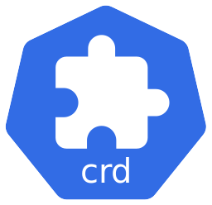





Azure Arc-enabled SQL Managed Instance AD authentication flow (system-managed)
3
Azure administrator deploy Active Directory Connector using System-managed keytab
2
Azure Arc data controller
Active Directory Connector (ADC) Kubernetes Custom Resource Definition (CRD)
Azure Administrator
Azure administrator deploy Azure Arc data controller
System-managed keytab deployment mode (auto-provisioned keytab)
DNS Proxy service
1
Azure administrator onboard Kubernetes cluster to Azure Arc
Azure Arc-enabled SQL Managed Instance
4
Database administrator deploy Azure Arc-enabled SQL Managed Instance
DNS resolution internal usage via ADC DNS server
5c
Client use received Kerberos ticket to authenticate against DB instance
Azure Arc-enabled Kubernetes cluster
5a
DB administrator send authentication request against Active Directory via SSMS and/or Azure Data Studio (ADS)
On-premises Active Directory Domain Services + DNS
Forward DNS resolution to on-premises DNS server
5b
Client receive Kerberos ticket
Database Administrator
0
On-premises AD administrator creates dedicated service account (DSA), SQLMI AD OU, and grant permissions on OUs to DSA
AD Administrator

Slide 32

Azur Azure Arc-enabled SQL Managed Instance AD authentication flow (customer-managed)
4
Azure administrator deploy Active Directory Connector using customer-managed keytab
2
Azure Arc data controller
Active Directory Connector (ADC) Kubernetes Custom Resource Definition (CRD)
Azure Administrator
Azure administrator deploy Azure Arc data controller
Customer-managed keytab deployment mode
DNS Proxy service
3
1
Azure administrator pulls keytab secret file from Azure Key Vault
Azure administrator onboard Kubernetes cluster to Azure Arc
Azure Arc-enabled SQL Managed Instance
Azure Key Vault
5
Database administrator deploy Azure Arc-enabled SQL Managed Instance
DNS resolution internal usage via ADC DNS server
6c
Client use received Kerberos ticket to authenticate against DB instance
Azure Arc-enabled Kubernetes cluster
6a
DB administrator send authentication request against Active Directory via SSMS and/or Azure Data Studio (ADS)
On-premises Active Directory Domain Services + DNS
6b
Forward DNS resolution to on-premises DNS server
Client receive Kerberos ticket
Database Administrator
0
On-premises AD administrator creates dedicated service account (DSA), SQLMI AD OU, and grant permissions on OUs to DSA
AD Administrator

Slide 33
Elastic scale

Slide 34
Scaling: Azure Arc-enabled SQL Managed Instance
Scale the same instance to match demand
Scale up via Azure portal and CLI cmd:
Increase processing power on your instances in few seconds by adding more vCores and Memory
Dynamically adjust your SQL instances capacity to match your business demand
Pay only for the resources consumed.
Set limits on how much instances can go up to
Set request are reserved instance will get entire amount allocated
Scale down:
Scale your memory and vCores down as demand decreases
Read Scale out:
Scale out your read workloads to secondary replica
Az CLI command
Azure Data Studio
2 vCores
4 GB
Scale up
16 vCores
64 GB
2 vCores
Scale down
4 GB
Available space
Used Cores/Memory

Slide 35
High availability

Slide 36
Azure Arc-enabled SQL Managed Instance High Availability
Deploy Azure Arc-enabled SQL Managed Instance with 2 or 3 replicas for increased reliability and scale out performance
Automated failovers and instance redeployment in event of pod/node failure
Ability to run read workloads on secondary instances
Resources
https://docs.microsoft.com/azure/azure-arc/data/managed-instance-high-availability

Slide 37
Azure Arc-enabled SQL Managed Instance
General Purpose High Availability
K8s Worker Node
Data Controller
Single replica
Single point of failure
If pod crashes, Kubernetes will spin a new pod and bring it online
Applications will need to reconnect to this new pod
Potential for downtime
K8s Worker Node
Pod
SQL MI
Load Balancer
Service
Service
Read-Only
Web App
Web App

Slide 38
Azure Arc-enabled SQL Managed Instance
Business Critical High Availability
K8s Worker Node
Data Controller
1
2
3
4
5
Built-in Setup
No other cluster technologies
Default configuration with 3 sync replicas
Primary and readable secondary endpoints
Automated Failover
Near zero downtime
K8s Worker Node
K8s Worker Node
K8s Worker Node
Pod
Pod
Pod
Availability
Group
SQL MI
Primary
SQL MI
Secondary
SQL MI
Secondary
AG agent
AG agent
AG agent
Load Balancer
Service
Web App

Slide 39
Azure Arc-enabled SQL Managed Instance
Business Critical High Availability
K8s Worker Node
Data Controller
1
2
3
4
5
Built-in Setup
No other cluster technologies
Default configuration with 3 sync replicas
Primary and readable secondary endpoints
Automated Failover
Near zero downtime
K8s Worker Node
K8s Worker Node
K8s Worker Node
Pod
Pod
Pod
Availability
Group
SQL MI
Primary
SQL MI
Secondary
SQL MI
Secondary
AG agent
AG agent
AG agent
Load Balancer
Service
Service
Read-Only
Web App
Web App

Slide 40
Azure Arc-enabled SQL Managed Instance
Business Critical High Availability
K8s Worker Node
Data Controller
1
2
3
4
5
Built-in Setup
No other cluster technologies
Default configuration with 3 sync replicas
Primary and readable secondary endpoints
Automated Failover
Near zero downtime
K8s Worker Node
K8s Worker Node
K8s Worker Node
Pod
Pod
Pod
Availability
Group
SQL MI
Primary
SQL MI
Secondary
SQL MI
Secondary
AG agent
AG agent
AG agent
Load Balancer
Service
Service
Read-Only
Web App
Web App

Slide 41
Azure Arc-enabled SQL Managed Instance
Business Critical High Availability
K8s Worker Node
Data Controller
1
2
3
4
5
Built-in Setup
No other cluster technologies
Default configuration with 3 sync replicas
Primary and readable secondary endpoints
Automated Failover
Near zero downtime
K8s Worker Node
K8s Worker Node
K8s Worker Node
Pod
Pod
Pod
Availability
Group
SQL MI
Primary
SQL MI
Primary
SQL MI
Secondary
AG agent
AG agent
AG agent
Load Balancer
Service
Service
Read-Only
Web App
Web App

Slide 42
Azure Arc-enabled SQL Managed Instance
Business Critical High Availability
K8s Worker Node
Data Controller
1
2
3
4
5
Built-in Setup
No other cluster technologies
Default configuration with 3 sync replicas
Primary and readable secondary endpoints
Automated Failover
Near zero downtime
K8s Worker Node
K8s Worker Node
K8s Worker Node
Pod
Pod
Pod
Availability
Group
SQL MI
Secondary
SQL MI
Primary
SQL MI
Secondary
AG agent
AG agent
AG agent
Load Balancer
Service
Service
Read-Only
Web App
Web App

Slide 43
Azure Arc-enabled SQL Managed Instance
Disaster Recovery using Failover Groups
K8s Worker Node
K8s Worker Node
Data Controller
Data Controller
K8s Worker Node
K8s Worker Node
K8s Worker Node
K8s Worker Node
K8s Worker Node
K8s Worker Node
Distributed
Availability
Group
Pod
Pod
Pod
Pod
Pod
Pod
Availability
Group
Availability
Group
SQL MI
Primary
SQL MI
Secondary
SQL MI
Secondary
SQL MI
Primary
SQL MI
Secondary
SQL MI
Secondary
AG agent
AG agent
AG agent
AG agent
AG agent
AG agent
Read-Write
Read-Only
Read-Write
Read-Only
Load Balancer
Load Balancer
R/W K8s Service
R/O K8s Service
R/W K8s Service
R/O K8s Service
Disaster Recovery (DR)
Multiple K8s clusters
App
App
App
App
Primary connections
DNS routing
DR connections
High Availability (HA)
Single K8s cluster – multiple nodes in Datacenter 1 (Primary Site)
Application clients
High Availability (HA)
Single K8s cluster – multiple nodes in Datacenter 2 (DR Site)

Slide 44
Architecture Diagrams

Slide 45


Azure Arc-enabled SQL Managed Instance storage logical architecture
Azure Arc-enabled Kubernetes cluster
Data Controller
Azure Arc-enabled SQL Managed Instance
Operator and Controller
SQL Database
Monitoring and Logs
SQL Database
SQL Database
Kubernetes storage resources
Backing storage infrastructure options
Public Cloud storage infrastructure
Network Array Storage (NAS)
Storage Area Network (SAN)
Kubernetes worker Directly-attached storage (DAS)

Slide 46
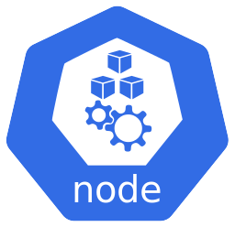




Kubernetes storage relations
Azure Arc-enabled Kubernetes cluster
Worker node
Worker node
Storage Class
Pod
Pod
PVC uses Storage Class to dynamically provision Persistent Volumes
Persistent Volume Claim (PVC)
Persistent Volume Claim (PVC)
Persistent Volume (PV)
Storage infrastructure type selected at deployment time
Storage infrastructure bases on Kubernetes StorageClass
Public Cloud StorageClass Provisioners
Remote on-premises StorageClass Provisioners
Local Kubernetes worker node StorageClass Provisioner
AzureDisk
AzureFile
AWS EBS
GCP GCE
…
VMware vSphere
NFS
Fiber Channel
Glusterfs
…
Local
(NVMe, SSD, HDD)

Slide 47
Azure Arc-enabled SQL Managed Instance Business Critical tier storage configuration
Azure Arc-enabled Kubernetes cluster
Worker node
Worker node
Worker node
Pod
Pod
Pod
Availability Group
Azure Arc-enabled SQL Managed Instance (0-Primary)
Azure Arc-enabled SQL Managed Instance (1-Secondary)
Azure Arc-enabled SQL Managed Instance (2-Secondary)
Only Primary instance writes to “Backup” persistent volume
Storage Classes
Backup Storage Class (ReadWriteMany)
Logs Storage Class
Data Storage Class
Data Logs Storage Class
Instance 0 Persistent Volumes
Instance 1 Persistent Volumes
Instance 2 Persistent Volumes
Backup PV
logs ( SQL Server logs)
logs ( SQL Server logs)
logs ( SQL Server logs)
data (database mdf files)
data (database mdf files)
data (database mdf files)
data-logs (database ldf files)
data-logs (database ldf files)
data-logs (database ldf files)

Slide 48
Azure Arc-enabled SQL Managed Instance General Purpose tier storage configuration
Azure Arc-enabled Kubernetes cluster
Worker node
Pod
Azure Arc-enabled SQL Managed Instance
Storage Classes
Logs Storage Class
Backup Storage Class (ReadWriteMany)
Data Storage Class
Data Logs Storage Class
Persistent Volumes
logs ( SQL Server logs)
Backup Persistent Volume
data (database mdf files)
data-logs (database ldf files)

Slide 49
Azure Arc-enabled SQL Managed Instance Data Controller storage configuration
Azure Arc-enabled Kubernetes cluster
Worker node
Pod
Data Controller
Storage Classes
Logs Storage Class
Data Storage Class
Controller SQL Persistent Volumes
Controller API Service Persistent Volumes
Metrics DB Persistent Volumes
Logs DB Persistent Volumes
Logs
Logs
Logs
Logs
Data
Data
Data
Data

Slide 50
Azure Arc-enabled SQL Managed Instance Disaster Recovery using Failover Groups – Primary site active
Azure Arc-enabled Kubernetes cluster
Kubernetes Worker Node
Kubernetes Worker Node
Data Controller
Data Controller
Kubernetes Worker Node
Kubernetes Worker Node
Kubernetes Worker Node
Kubernetes Worker Node
Kubernetes Worker Node
Kubernetes Worker Node
Distributed
Availability
Group
Pod
Pod
Pod
Pod
Pod
Pod
Availability
Group
Arc SQL MI
Primary Instance
Arc SQL MI
Secondary
Instance
Arc SQL MI
Secondary
Instance
Availability
Group
Arc SQL MI
Primary Instance
Arc SQL MI
Secondary
Instance
Arc SQL MI
Secondary
Instance
AG agent
AG agent
AG agent
AG agent
AG agent
AG agent
Kubernetes Load Balancer
Kubernetes Load Balancer
Read-Write
Read-Only
Standby
on DR site
Standby
on DR site
App
App
Disaster Recovery (DR)
Multiple K8s clusters
App
App
DNS routing
High Availability (HA)
Single K8s cluster – multiple nodes in Datacenter 1 (Primary Site)
Application clients
High Availability (HA)
Single K8s cluster – multiple nodes in Datacenter 2 (DR Site)

Slide 51
Azure Arc-enabled SQL Managed Instance Disaster Recovery using Failover Groups – DR initiated
Azure Arc-enabled Kubernetes cluster
Kubernetes Worker Node
Kubernetes Worker Node
Data Controller
Data Controller
Kubernetes Worker Node
Kubernetes Worker Node
Kubernetes Worker Node
Kubernetes Worker Node
Kubernetes Worker Node
Kubernetes Worker Node
Distributed
Availability
Group
Pod
Pod
Pod
Pod
Pod
Pod
Availability
Group
Arc SQL MI
Primary Instance
Arc SQL MI
Secondary
Instance
Arc SQL MI
Secondary
Instance
Availability
Group
Arc SQL MI
Primary Instance
Arc SQL MI
Secondary
Instance
Arc SQL MI
Secondary
Instance
AG agent
AG agent
AG agent
AG agent
AG agent
AG agent
Kubernetes Load Balancer
Kubernetes Load Balancer
Standby
on DR site
Standby
on DR site
Read-Write
Read-Only
App
App
Disaster Recovery (DR)
Multiple K8s clusters
App
App
DNS routing
High Availability (HA)
Single K8s cluster – multiple nodes in Datacenter 2 (DR Site)
Application clients
High Availability (HA)
Single K8s cluster – multiple nodes in Datacenter 1 (Primary Site)

Slide 52
Azure Arc-enabled SQL Managed Instance High Availability – Operational state
Azure Arc-enabled Kubernetes cluster
Kubernetes Worker Node
Data Controller
Kubernetes Worker Node
Kubernetes Worker Node
Kubernetes Worker Node
Pod
Pod
Pod
Availability
Group
Arc SQL MI
Primary Instance
Arc SQL MI
Secondary
Instance
Arc SQL MI
Secondary
Instance
AG agent
AG agent
AG agent
Kubernetes Load Balancer
Read-Write
Read-Only
App
App

Slide 53
Azure Arc-enabled SQL Managed Instance High Availability – Secondary instance promote to Primary
Azure Arc-enabled Kubernetes cluster
1
Arc-enabled SQL MI primary instance Kubernetes Pod failure
Kubernetes Worker Node
Data Controller
Kubernetes Worker Node
Kubernetes Worker Node
Kubernetes Worker Node
Pod
Pod
1
Pod failure
Availability
Group
Arc SQL MI
Secondary
Instance
Arc SQL MI
Secondary
Instance
AG agent
AG agent
Kubernetes Load Balancer
Read-Write
Read-Only
App
App

Slide 54
Azure Arc-enabled SQL Managed Instance High Availability – Primary instance Pod failure
Azure Arc-enabled Kubernetes cluster
1
Arc-enabled SQL MI primary instance Kubernetes Pod failure
Secondary instance promoted to “Primary” and starts receiving “Read-Write” traffic
Kubernetes Worker Node
2
Data Controller
Kubernetes Worker Node
Kubernetes Worker Node
Kubernetes Worker Node
Pod
Pod
1
Pod failure
Availability
Group
Arc SQL MI
Primary
Instance
Arc SQL MI
Secondary
Instance
2
AG agent
AG agent
2
Kubernetes Load Balancer
Read-Write
Read-Only
App
App

Slide 55
Azure Arc-enabled SQL Managed Instance High Availability – Operational state restored
Secondary instance promoted to “Primary” and starts receiving “Read-Write” traffic
Azure Arc-enabled Kubernetes cluster
2
Upon Pod recovery, additional Secondary instance is recovered and receives Read-Only traffic
Kubernetes Worker Node
3
Data Controller
Kubernetes Worker Node
Kubernetes Worker Node
Kubernetes Worker Node
Pod
Pod
Pod
Availability
Group
Arc SQL MI
Secondary
Instance
Arc SQL MI
Primary
Instance
Arc SQL MI
Secondary
Instance
3
2
AG agent
AG agent
AG agent
2
3
Kubernetes Load Balancer
Read-Write
Read-Only
App
App

Slide 56


Azure Arc-enabled SQL Managed Instance Custom Locations namespace mapping
Data Controller
Azure Arc-enabled SQL Managed Instance
Other Azure Arc-enabled services
Custom location to namespace A mapping
Custom location to namespace B mapping
Azure Arc-enabled Kubernetes
Kubernetes namespace A
Kubernetes namespace B

Slide 57

Azure Arc-enabled SQL Managed Instance Custom Locations Azure tags mapping
Team : Dev Tag
Location : Hospital Tag
Azure Arc-enabled Kubernetes
Azure Arc-enabled Kubernetes
Team : Dev-Backend Tag
Team : Dev-Backend Tag
Apps : Records
Tag
Apps : Records
Tag
Data Controller
Azure Arc-enabled SQL Managed Instance
Data Controller
Azure Arc-enabled SQL Managed Instance
Team : Dev-Backend Tag
Apps : Records
Tag
Custom location to backend namespace mapping
Custom location to records namespace mapping
Kubernetes namespace backend
Kubernetes namespace records

Slide 58





Azure Arc-enabled data services Directly Connected mode data service upgrade flow
Azure
Data Controller upgrade path
1
Azure Resource Manager
Microsoft Artifact Registry
Initiating the upgrade request
Arc-enabled SQL MI upgrade path
Upgrade interfaces
User-owned Infrastructure
4
Pull images from Microsoft Artifact Registry
Azure portal
Azure Arc-enabled Kubernetes cluster
2
Check for Data Controller and Arc-enabled SQL MI version updates in ARM
Optional: Data Controller upgrade based upon Auto Upgrade and Maintenance Window Configuration
Azure CLI
Azure Arc-enabled Kubernetes agents
Azure Arc Data Controller
Private Container Registry
Upgrade Data Controller to specified version
Azure Data Studio
3
4
In-cluster K8s API call to perform upgrades on both Data Controller and Arc-enabled SQL MI
Optional: Pull images from private container registry
4
Upgrade Arc-enabled SQL MI to specified version
Kubernetes API server & Control Plane
Azure Arc-enabled SQL Managed Instance
Optional: Trigger Arc-enabled SQL MI upgrade post Data Controller upgrade, based upon Auto Upgrade and Maintenance Window Configuration

Slide 59
Azure Arc-enabled data services Indirectly Connected mode data service upgrade flow
Azure
Microsoft Artifact Registry
Upgrade interfaces
kubectl CLI
User-owned Infrastructure
2
Pull images from Microsoft Artifact Registry
Kubernetes cluster
Azure CLI
Optional: Data Controller upgrade based upon Auto Upgrade and Maintenance Window Configuration
Azure Arc Data Controller
Private Container Registry
Azure Data Studio
Upgrade Data Controller to specified version
2
Optional: Pull images from private container registry
Initiating the upgrade request
2
1
Upgrade Arc-enabled SQL MI to specified version
Kubernetes API server & Control Plane
Azure Arc-enabled SQL Managed Instance
Data Controller upgrade path
Optional: Trigger Arc-enabled SQL MI upgrade post Data Controller upgrade, based upon Auto Upgrade and Maintenance Window Configuration
Arc-enabled SQL MI upgrade path

Slide 60
Azure Arc-enabled SQL Managed Instance General Purpose tier upgrade flow – Pre-upgrade
Azure Arc-enabled Kubernetes cluster
Kubernetes Worker Node
Data Controller
1
Arc-enabled SQL MI upgrade orchestrated by the Data Controller following user-triggered upgrade or based on Automatic Upgrade configuration
Kubernetes Worker Node
Pod
Arc SQL MI
State: Unpatched

Slide 61
Azure Arc-enabled SQL Managed Instance General Purpose tier upgrade flow – Pod termination and new, upgraded instance instantiation
Azure Arc-enabled Kubernetes cluster
Kubernetes Worker Node
1
Data Controller
Arc-enabled SQL MI upgrade orchestrated by the Data Controller following user-triggered upgrade or based on Automatic Upgrade configuration
Kubernetes Worker Node
Pod
Pod
Pod state: Terminated
Arc SQL MI
Arc SQL MI
State: Unpatched
State: Patched
2
3
Active Pod is Terminated
New Pod with upgraded
Arc-enabled SQL MI version is created

Slide 62
Azure Arc-enabled SQL Managed Instance Business Critical tier upgrade flow – Pre-upgrade
Azure Arc-enabled Kubernetes cluster
1
Kubernetes Worker Node
Arc-enabled SQL MI upgrade orchestrated by the Data Controller following user-triggered upgrade or based on Automatic Upgrade configuration
Data Controller
Kubernetes Worker Node
Kubernetes Worker Node
Kubernetes Worker Node
Pod
Pod
Pod
Availability
Group
Arc SQL MI
Primary Instance
Arc SQL MI
Secondary
Instance
Arc SQL MI
Secondary
Instance
State: Unpatched
State: Unpatched
State: Unpatched

Slide 63
Azure Arc-enabled SQL Managed Instance Business Critical tier upgrade flow – Pod termination and new, upgraded instance instantiation
Azure Arc-enabled Kubernetes cluster
1
Kubernetes Worker Node
Arc-enabled SQL MI upgrade orchestrated by the Data Controller following user-triggered upgrade or based on Automatic Upgrade configuration
Data Controller
Kubernetes Worker Node
Kubernetes Worker Node
Kubernetes Worker Node
Pod
Pod
Pod
Pod
Arc SQL MI
Primary Instance
Arc SQL MI
Secondary
Instance
Pod state: Terminated
Availability
Group
Arc SQL MI
Secondary
Instance
Arc SQL MI
Secondary
Instance
State: Unpatched
State: Unpatched
AG agent
State: Patched
2
Existing Secondary Pod is Terminated
3
New Pod with upgraded
Arc-enabled SQL MI version is created

Slide 64
Azure Arc-enabled SQL Managed Instance Business Critical tier upgrade flow – Remaining secondary replicas upgrade rollout
Azure Arc-enabled Kubernetes cluster
1
Kubernetes Worker Node
Arc-enabled SQL MI upgrade orchestrated by the Data Controller following user-triggered upgrade or based on Automatic Upgrade configuration
Data Controller
Kubernetes Worker Node
Kubernetes Worker Node
Kubernetes Worker Node
Pod
Pod
Pod
Pod
Arc SQL MI
Primary Instance
Arc SQL MI
Secondary
Instance
Pod state: Terminated
Availability
Group
Arc SQL MI
Secondary
Instance
Arc SQL MI
Secondary
Instance
State: Unpatched
State: Patched
AG agent
State: Patched
2
Existing Secondary Pod is Terminated
3
New Pod with upgraded
Arc-enabled SQL MI version is created
4
Steps 2+3 are repeated for all remaining Secondary Replicas

Slide 65
Azure Arc-enabled SQL Managed Instance Business Critical tier upgrade flow – SQL-level failover and last Pod instantiation
Azure Arc-enabled Kubernetes cluster
Kubernetes Worker Node
Data Controller
Kubernetes Worker Node
Kubernetes Worker Node
Kubernetes Worker Node
Pod
Pod
Pod
Pod
Pod state: Terminated
Availability
Group
Arc SQL MI
Secondary
Instance
Arc SQL MI
Primary Instance
Arc SQL MI
Primary Instance
Arc SQL MI
Secondary
Instance
State: Patched
State: Unpatched
State: Patched
State: Patched
Last Pod instantiated as secondary replica
6
Terminating Pod
Promoting to Primary
5
Once all secondary replica upgrades are completed, the Data Controller triggers a SQL-level Failover, which promotes an upgraded Secondary to become the new Primary

Slide 66










Azure Arc-enabled data services Network connectivity integrations
Azure Virtual Network
Microsoft Artifact Registry Private Endpoint
Microsoft Artifact Registry Private Endpoint
SaaS Git services (i.e GitHub, Azure DevOps)
Microsoft Artifact Registry (Private)
Azure Monitor
Private Link Scope
Azure Log Analytics Workspace
Azure ExpressRoute / S2S VPN
HTTPs/443
Azure Resource Manager
Connectivity via user-owned proxy and/or firewall
Connectivity via user-owned proxy and/or firewall
Direct connectivity via internet
User-owned Infrastructure (on-premises / Multicloud)
Connectivity via user-owned network infrastructure
On-premises Active Directory Domain Services + DNS
Azure Arc-enabled Kubernetes cluster
TCP/UDP 53,88,3268,3269
Azure Arc-enabled SQL Managed Instance
Azure Arc Data Controller

Slide 67




Azure Arc-enabled SQL Managed Instance Client-Server network connectivity flow example
Azure Data Factory
Data ingestion over HTTPs/443
Azure Synapse Analytics
Azure Data Factory connects to SSIS proxy
1
2
Self-Hosted SSIS IR as a Proxy
SSIS proxy forwards database connection requests to Arc-enabled SQL MI
Azure Arc-enabled Kubernetes cluster
Kubernetes Worker Node
1
2
User access web application over HTTPs/443
Web application
Web application connects to Arc-enabled SQL MI via LoadBalancer 1433 port or random NodePort port
Azure Arc-enabled SQL Managed Instance
Azure Arc Data Controller
Application user
On-premises Active Directory Domain Services (AADS) + DNS
4
3
Web application requests Kerberos token with ADDS
Arc-enabled SQL MI does DNS resolution and queries user information in ADDS
User-owned Infrastructure (on-premises / Multicloud)

Slide 68
Azure Arc-enabled SQL Managed Instance SSIS SQL authentication secured access flow example
1
Data engineer configures Azure Data Factory to integrate with Arc-enabled SQL MI for data extraction using SQL authentication
Azure Data Factory
Azure Synapse Analytics
Data ingestion over HTTPs/443
Data engineer
Azure Data Factory connects to Arc-enabled SQL MI using SQL authentication for pulling on-premises data
2
Azure Arc-enabled Kubernetes cluster
Kubernetes Worker Node
Self-Hosted SSIS IR as a Proxy
3b
Arc-enabled SQL MI verifies SQL credentials and allows connection to the database
Azure Arc-enabled SQL Managed Instance
Azure Arc Data Controller
3a
SSIS proxy forwards connection request to Arc-enabled SQL MI
User-owned Infrastructure (on-premises / Multicloud)

Slide 69
Azure Arc-enabled SQL Managed Instance Active Directory authentication secured access flow example
Azure Arc-enabled Kubernetes cluster
1
Web application
Kubernetes Worker Node
User access web application
2b
Arc-enabled SQL MI challenges for Kerberos authentication
Azure Arc-enabled SQL Managed Instance
Azure Arc Data Controller
Application user
Web application connects to SQL database
2a
Web application presents Kerberos token to Arc-enabled SQL MI
2d
On-premises Active Directory Domain Services (AADS) + DNS
3
Arc-enabled SQL MI verifies Kerberos token and allows SQL connection
2c
Web application request Kerberos token from ADDS and ADDS issues Kerberos token
User-owned Infrastructure (on-premises / Multicloud)

Slide 70

















Azure Arc-enabled data services security and governance overview
User interfaces
Azure portal
Azure REST API
Azure AD (RBAC)
Azure ARM Templates
Azure Tags
Azure Resource Graph
Azure Audit
Azure CLI
PowerShell
Azure Monitor
Azure Log Analytics
Microsoft Sentinel
Microsoft Artifact Registry
kubectl CLI
Resource Inventory
Billing
Monitoring & Logs
Governance
Compliance & Security
Native Azure
Azure Arc Integration
Transparent data encryption
Monitoring & Logs
Transport Layer Security
Extensibility
AD DS Authentication
Active Directory Domain Services + DNS
Active Directory Domain Services + DNS
Active Directory Domain Services + DNS
Active Directory Domain Services + DNS
Active Directory Domain Services + DNS
Azure Arc-enabled services
Azure Arc-enabled services
Azure Arc-enabled services
Azure Arc-enabled services
Azure Arc-enabled services
Custom Location
Mapping
Custom Location
Mapping
Custom Location
Mapping
Custom Location
Mapping
Custom Location
Mapping
Azure Arc-enabled Kubernetes clusters
Azure Arc-enabled Kubernetes clusters
Azure Arc-enabled Kubernetes clusters
Azure Arc-enabled Kubernetes clusters
Azure Arc-enabled Kubernetes clusters
Kubernetes Resources
Kubernetes Resources
Kubernetes Resources
Kubernetes Resources
Kubernetes Resources
K8s API
K8s API
K8s API
K8s API
K8s API
Azure Kubernetes Service (AKS) clusters
Azure Kubernetes Service (AKS) on Azure Stack HCI clusters
VMware Tanzu Grid (TKG) clusters
Elastic Kubernetes Service (EKS) clusters
Google Kubernetes Engine (GKE) clusters
Azure
Azure Stack HCI
VMware vSphere
Amazon Web Services
Google Cloud Platform

Slide 71


Azure Arc-enabled data services On-premises and multicloud integration
User Interface
Azure Policy
Azure AD (RBAC)
Azure ARM Templates
Azure Tags
Azure Resource Graph
Azure Audit
GitOps Configurations
Azure Portal
Azure REST API
Azure Monitor
Azure Log Analytics
Microsoft Defender for Cloud
Microsoft Sentinel
Azure Key Vault
Microsoft Container Registry
Azure CLI
PowerShell
Resource Inventory
Billing
Monitoring & Logs
Secrets Management
Governance
Compliance & Security
kubectl CLI
Azure Data Studio
Azure Arc Integration
Threat Protection
Monitoring & Logs
Secrets
Change Tracking
Extensibility
Patching & Updates
Automanage
Azure Arc data controller
Azure Arc data controller
Azure Arc data controller
Azure Arc data controller
Azure Arc data controller
Azure Arc-enabled data services (SQLMI/PGHS)
Azure Arc-enabled data services (SQLMI/PGHS)
Azure Arc-enabled data services (SQLMI/PGHS)
Azure Arc-enabled data services (SQLMI/PGHS)
Azure Arc-enabled data services (SQLMI/PGHS)
Custom Location
Mapping
Custom Location
Mapping
Custom Location
Mapping
Custom Location
Mapping
Custom Location
Mapping
Azure Arc-enabled Kubernetes clusters
Azure Arc-enabled Kubernetes clusters
Azure Arc-enabled Kubernetes clusters
Azure Arc-enabled Kubernetes clusters
Azure Arc-enabled Kubernetes clusters
Kubernetes Resources
Kubernetes Resources
Kubernetes Resources
Kubernetes Resources
Kubernetes Resources
K8s API
K8s API
K8s API
K8s API
K8s API
Azure Kubernetes Service (AKS) clusters
Azure Kubernetes Service (AKS) on Azure Stack HCI clusters
VMware Tanzu Grid (TKG) clusters
Elastic Kubernetes Service (EKS) clusters
Google Kubernetes Engine (GKE) clusters
Azure
Azure Stack HCI
VMware vSphere
Amazon Web Services
Google Cloud Platform

Slide 72






Azure Arc-enabled services On-premises and multicloud integration
User Interface
Azure Policy
Azure AD (RBAC)
Azure ARM Templates
Azure Tags
Azure Resource Graph
Azure Audit
GitOps Configurations
Azure Portal
Azure REST API
Azure Monitor
Azure Log Analytics
Microsoft Defender for Cloud
Microsoft Sentinel
Azure Key Vault
Microsoft Container Registry
Azure CLI
PowerShell
Resource Inventory
Billing
Monitoring & Logs
Secrets Management
Governance
Compliance & Security
kubectl CLI
Azure Arc Integration
Threat Protection
Monitoring & Logs
Secrets
Change Tracking
Extensibility
Patching & Updates
Automanage
Azure Arc-enabled services (data/app/ML)
Azure Arc-enabled services (data/app/ML)
Azure Arc-enabled services (data/app/ML)
Azure Arc-enabled services (data/app/ML)
Azure Arc-enabled services (data/app/ML)
Custom Location
Mapping
Custom Location
Mapping
Custom Location
Mapping
Custom Location
Mapping
Custom Location
Mapping
Azure Arc-enabled Kubernetes clusters
Azure Arc-enabled Kubernetes clusters
Azure Arc-enabled Kubernetes clusters
Azure Arc-enabled Kubernetes clusters
Azure Arc-enabled Kubernetes clusters
Kubernetes Resources
Kubernetes Resources
Kubernetes Resources
Kubernetes Resources
Kubernetes Resources
K8s API
K8s API
K8s API
K8s API
K8s API
Azure Kubernetes Service (AKS) clusters
Azure Kubernetes Service (AKS) on Azure Stack HCI clusters
VMware Tanzu Grid (TKG) clusters
Elastic Kubernetes Service (EKS) clusters
Google Kubernetes Engine (GKE) clusters
Azure
Azure Stack HCI
VMware vSphere
Amazon Web Services
Google Cloud Platform

Slide 73
DEMO TIME

Slide 74
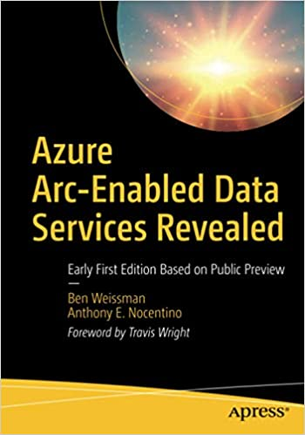
Resources for you
beard.media\Presentations
Azure Arc jumpstart
https://azurearcjumpstart.io
Azure Arc enabled data services
https://docs.microsoft.com/en-us/azure/azure-arc/data/
Azure Arc enabled SQL Managed Instance Overview
https://docs.microsoft.com/en-us/azure/azure-arc/data/managed-instance-overview
Azure Arc enabled PostgreSQL Hyperscale
https://docs.microsoft.com/en-us/azure/azure-arc/data/what-is-azure-arc-enabled-postgres-hyperscale
azdata reference
https://docs.microsoft.com/en-us/sql/azdata/reference/reference-azdata

Slide 75
Thank you
@sqldbawithbeard
robsewell.com
beard.media\book

